Slide 1

Evaluating the Impact of Vehicular and Industrial Activities on AQI : Insights from AQI Improvements During COVID-19 Lockdowns
AQI ANALYSIS

Slide 2
Presented by and inspiration
Course instructor:
PROFESSOR Thaseem thajudeen
Professor anirudha ambekar
Group members(G4):
NITIN KUMAR YADAV
Deepak Kumar
Avinash Choudhry
Date – 22/11/2024

Slide 3
What is AQI ?
A standardized measure that indicates the level of air pollution and its potential impact on human health, ranging from "Good" to "Hazardous“.

Slide 4
Introduction to Air Pollution: A Global Crisis
The Growing Threat of Air Pollution
Air pollution is one of the most urgent global challenges of the 21st century, affecting human health, the environment, and economic stability.
Shocking Global Statistics
99% of the world’s population lives in areas where air pollution exceeds safe levels (World Health Organization, 2021).
6.7 million deaths globally in 2019 linked to air pollution—making it a leading cause of premature mortality.
Economic Impact
Air pollution costs the global economy $8.1 trillion annually—6.1% of global GDP (World Bank, 2021).
India's Crisis: The World’s Most Polluted Cities
In India, rapid industrial growth and urbanization have resulted in 15 out of 20 of the world’s most polluted cities (IQAir, 2018).

Slide 5
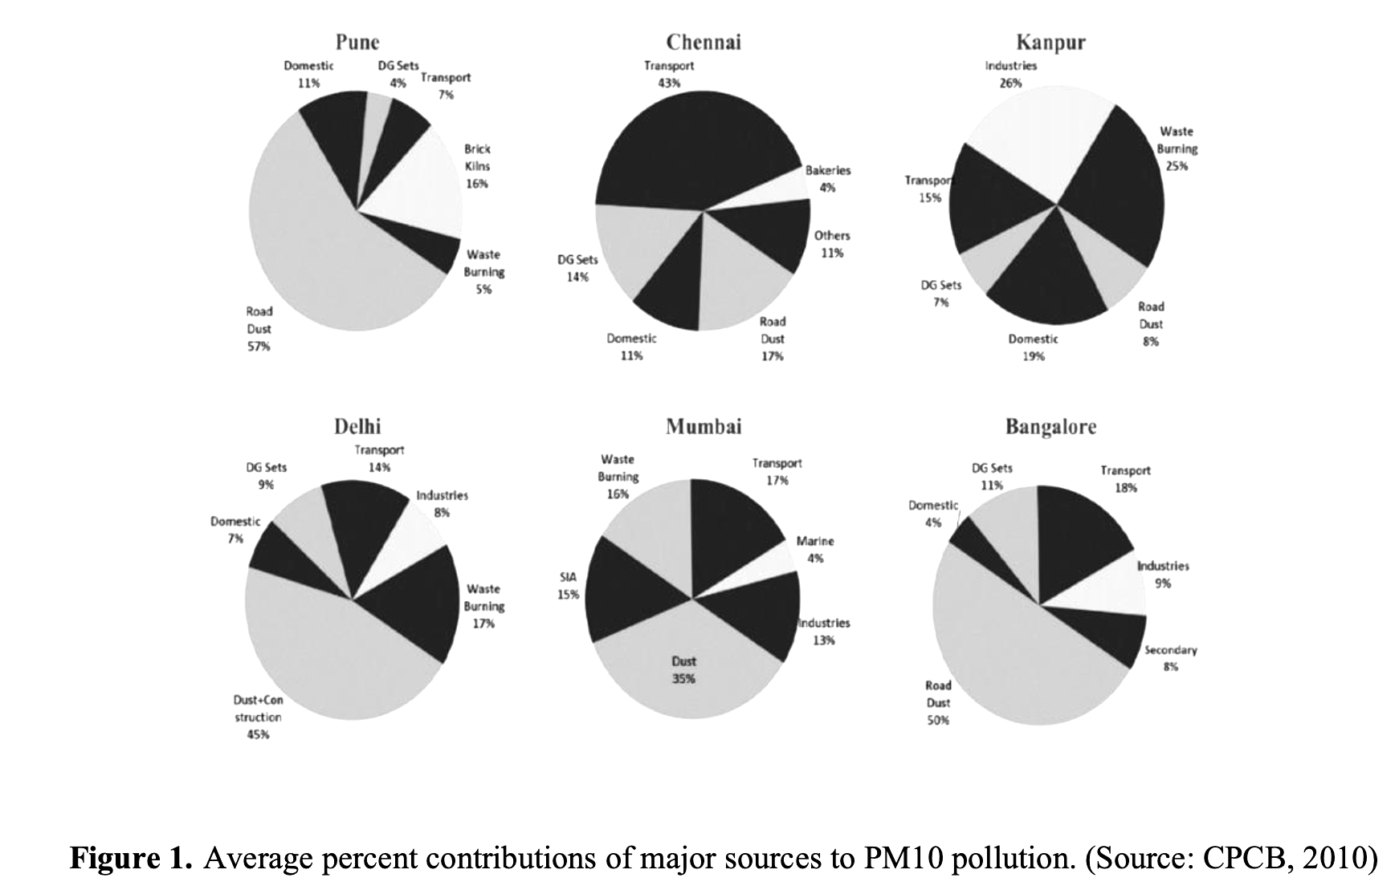
Key Contributors to Air Pollution
Major Sources :
Vehicular emissions (road dust, vehicle exhaust).
Industrial emissions (factories, power plants).

Slide 6
Major Pollutants measured under AQI
CO
SO2
NO2
PM₂.₅
PM₁₀

Slide 7
Objectives
Collecting data of AQI of different cities.
Before and during the different phases of corona.
Observing the patterns in the AQI stats.
Suggesting the solutions to overcome the pollution in contrast to reductions in pollutant levels we had during corona times.
Economic aspects of the policies and proposed solutions.

Slide 8
Methodology
Data Sources
Air quality data from the CAAQM Network (CPCB).
Accessed via OpenAQ.org, a global platform for air quality data.
Key Phases of Lockdown
Lockdown Phase 1 (March 25 – April 14, 2020) : Strict nationwide lockdown, only essential services allowed.
Lockdown Phase 2 (April 15 – May 3, 2020) : Partial relaxations in rural areas, sector-specific restrictions based on COVID-19 zones (red, orange, green).
Lockdown Phase 3 (May 4 – May 17, 2020) : Further relaxations, including reopening businesses in lower-risk zones; limited public transport.
Pollutants Analyzed
PM10, PM2.5: Particulate Matter, critical indicators of urban air quality.
SO2: Sulphur Dioxide, a key industrial pollutant.
NO2: Nitrogen Dioxide, primarily from vehicular emissions.
CO: Carbon Monoxide
Averages Computed:
Daily Averages for PM10, PM2.5, SO2, and NO2.
Daytime Averages for CO.

Slide 9
Cities chosen for data collection
Mumbai
Kolkata
Delhi
Nagpur
Jaipur
Chennai

Slide 10
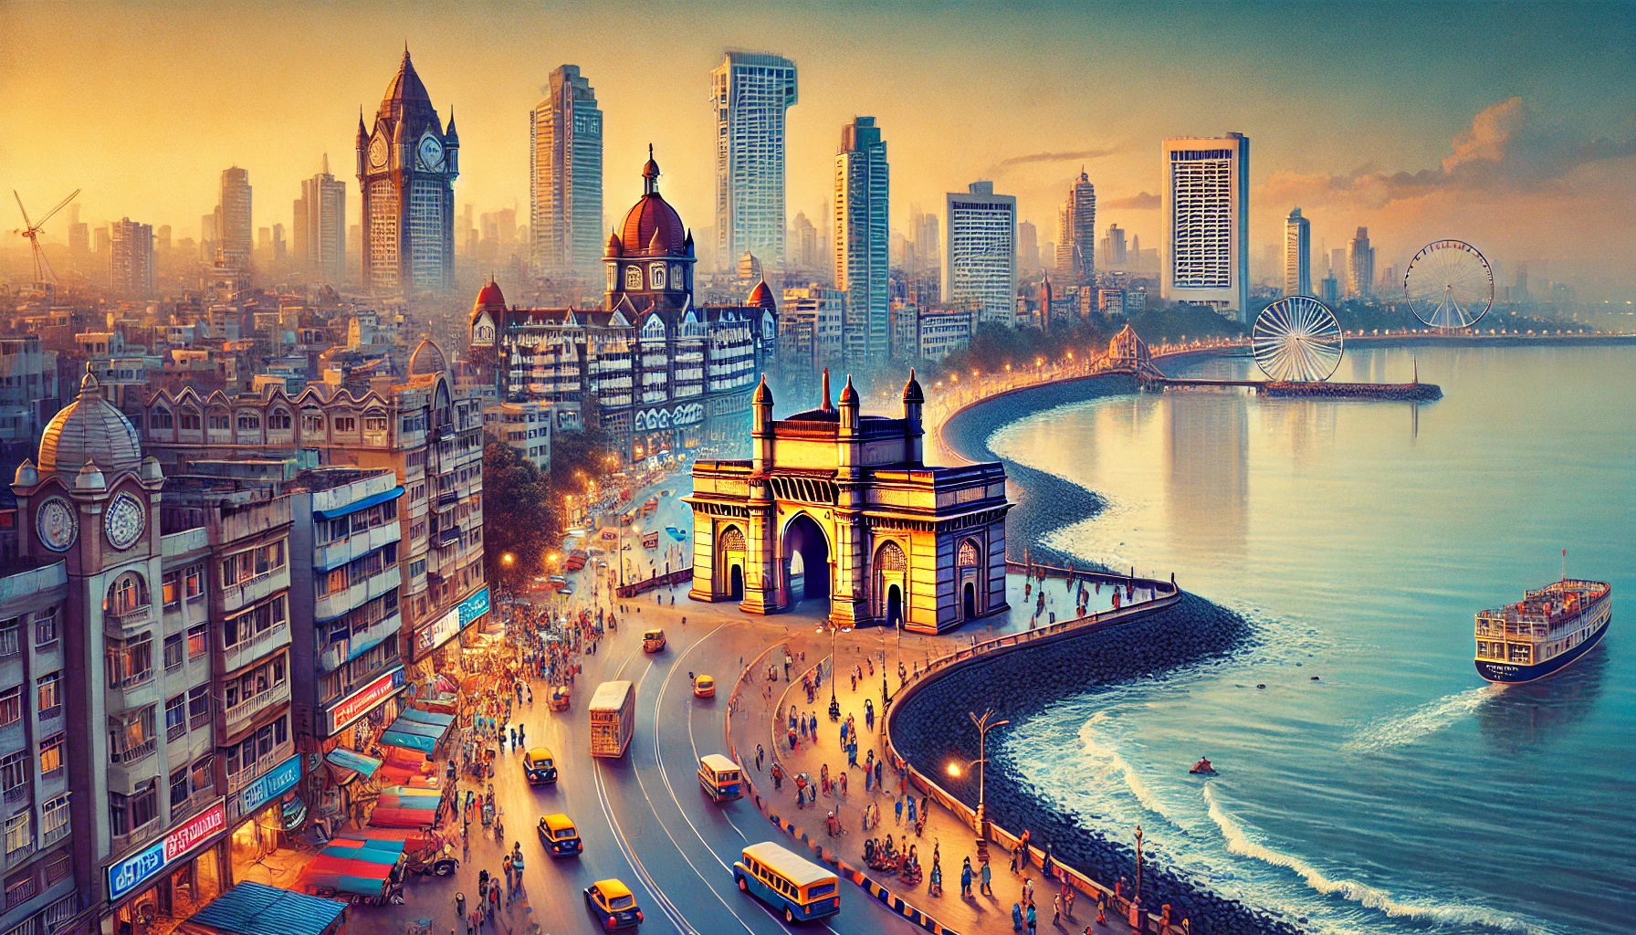
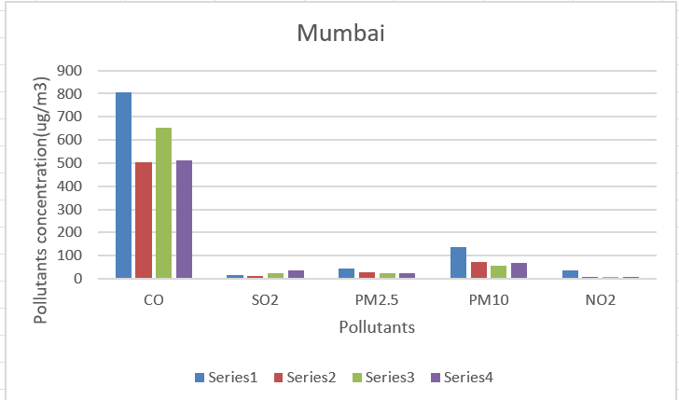
Mumbai

Slide 11
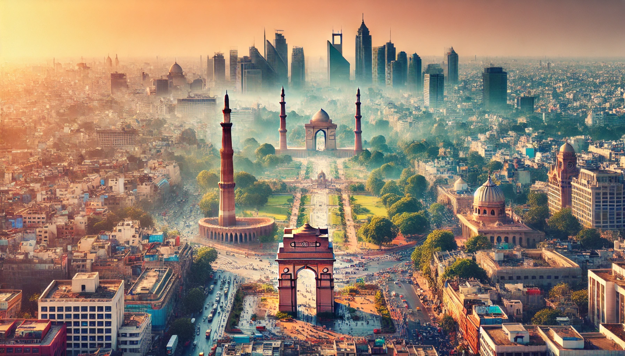
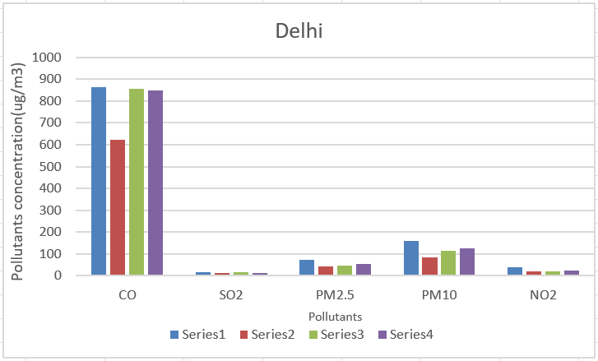
Delhi

Slide 12
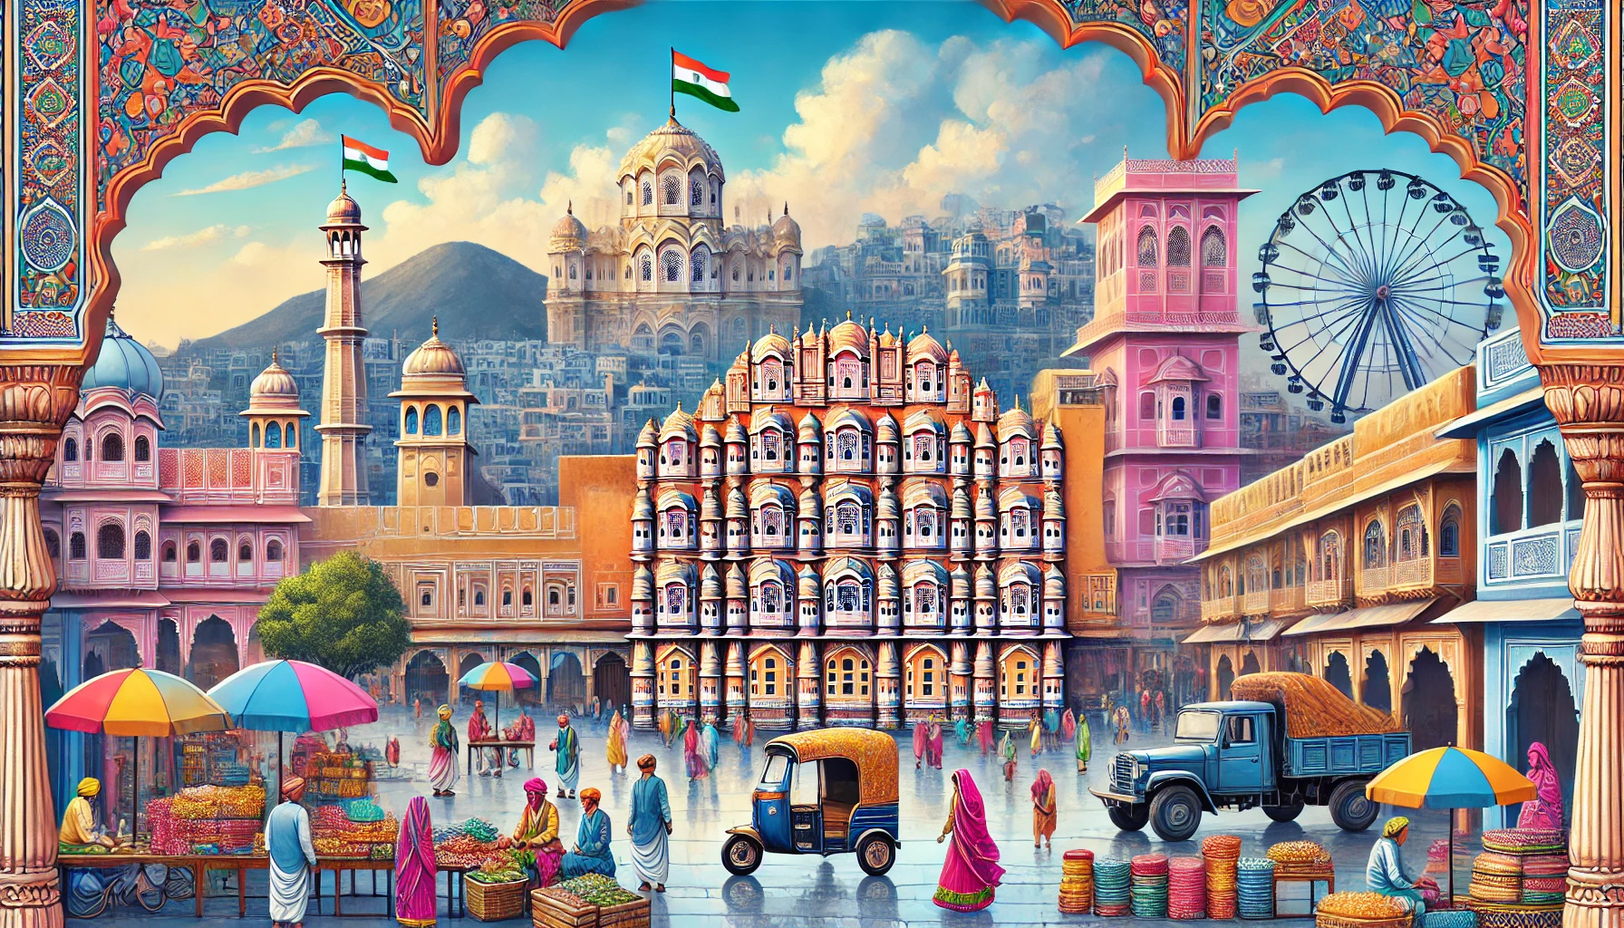
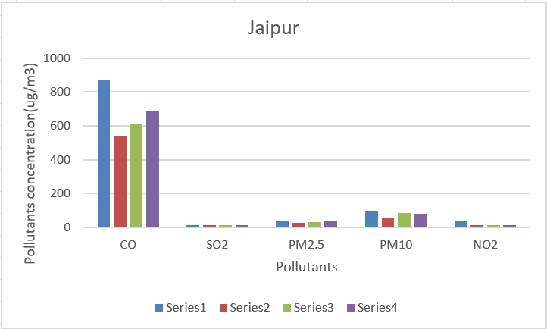
Jaipur

Slide 13
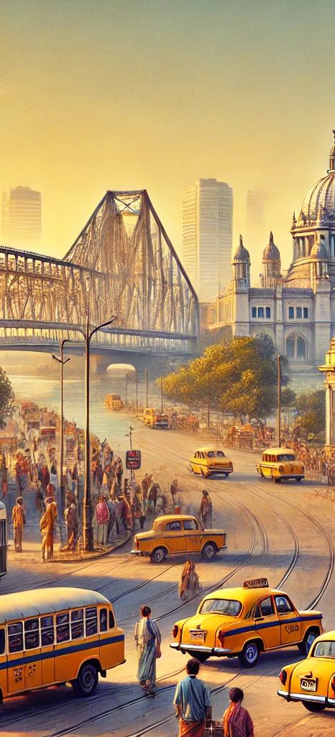
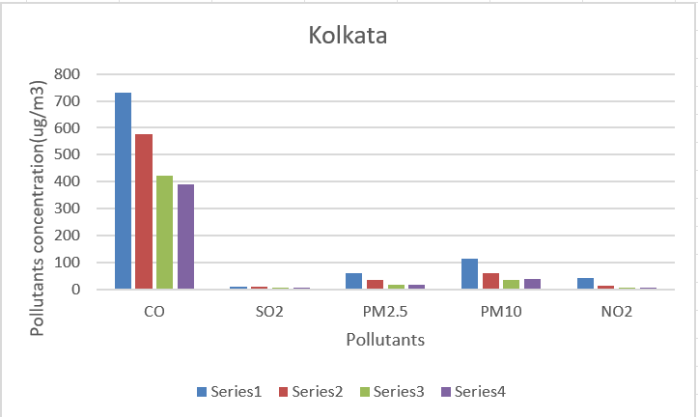
Kolkata

Slide 14
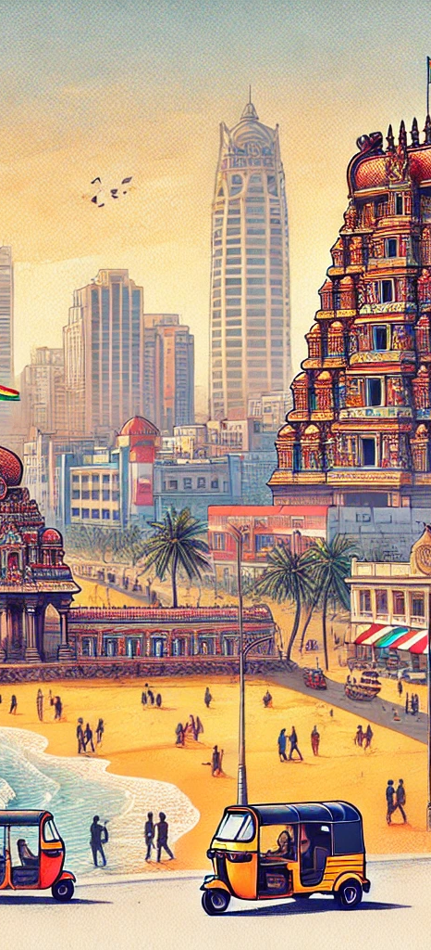
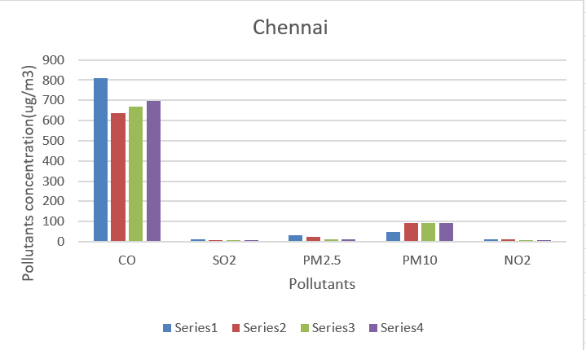
Chennai

Slide 15
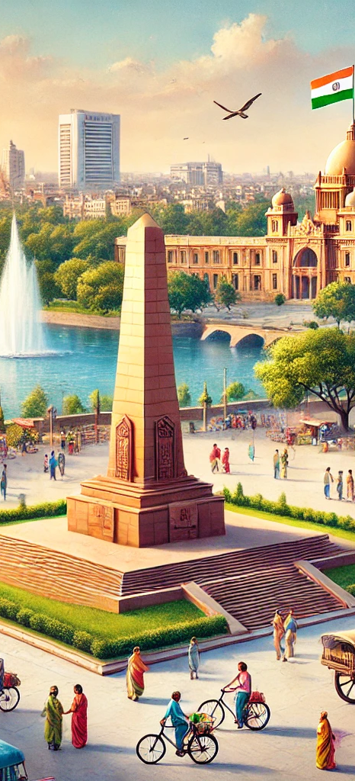
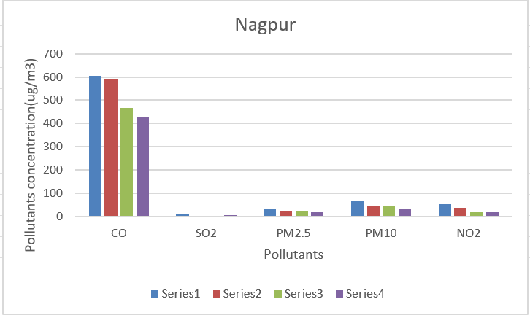
Nagpur

Slide 16
General reasons for reduction in the levels of pollutants during covid
Reduced Transportation.
Decline in Industrial Activities.
Lower Energy Demand.
Limited Aviation.
Decreased Construction Activities.
Reduced Maritime Activities.
Behavioural Changes.

Slide 17
Economic and Social Benefits
Healthcare Savings: Reduced respiratory diseases.
Job Creation: Green tech and retrofitting hubs.
Sustainability: Aligning economic growth with environmental goals.

Slide 18
Proposed Solutions
For Urban Areas:
Stricter emission standards.
Promotion of electric vehicles.
Dust control measures.
For Rural Areas:
Biofuel incentives.
Retrofit older equipment.
Awareness campaigns.

Slide 19
Economic Feasibility and Success of Pollution Control Policies
Initial Costs vs. Long-Term Benefits
Policy Instruments for Feasibility
Challenges in Developing Countries

Slide 20
Global Examples of Policy Success
Clean Air Act (USA)
California’s Low Carbon Fuel Standard (LCFS)
China’s Electric Vehicle Policy

Slide 21
Economic Benefits of Pollution Control
Healthcare Cost Savings
Job Creation
Increased Agricultural Productivity

Slide 22
Key Indicators of Success
Measurable Declines in Pollutants
Public Adoption of Technologies
Sustained Economic Growth

Slide 23
THANK YOU

